Slide 1

Internet Control Message Protocol Version 4 (ICMPv4)
Gouasmia Zakaria
Gouasmia.zakaria1@gmail.com

Slide 2
OBJECTIVES:
rationale for the existence of ICMP.
how ICMP messages are divided into two categories: error reporting and query messages.
the purpose and format of error-reporting messages.
the purpose and format of query messages.
how the checksum is calculated for an ICMP message.
how debugging tools using the ICMP protocol.
how a simple software package that implements ICMP is organized.

Slide 3
1-INTRODUCTION
The IP protocol has no error-reporting or error correcting mechanism.
What happens if something goes wrong? What happens if a router must discard a datagram because it cannot find a router to the final destination, These are examples of situations where an error has occurred and the IP protocol has no built-in mechanism to notify the original host.

Slide 4
Discussed in the Section
The position of ICMP in the TCP/IP suite
Encapsulation of ICMP Packets

Slide 5
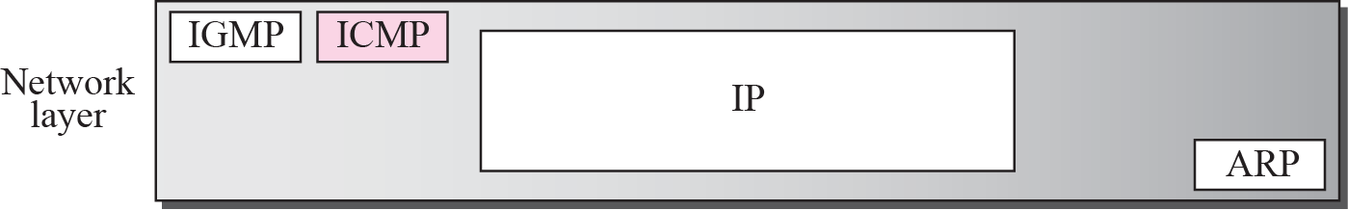
Position of ICMP in the network layer

Slide 6
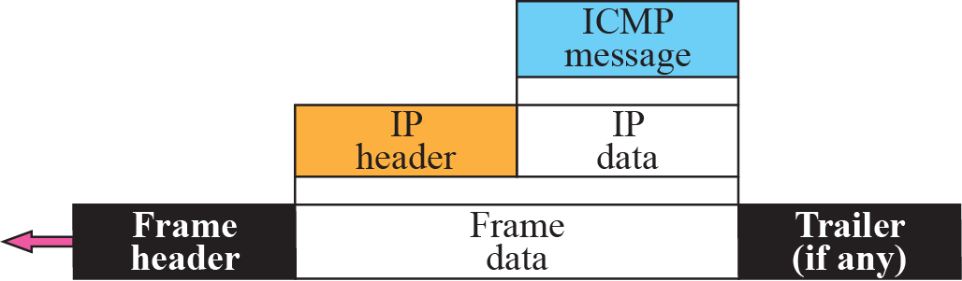
ICMP encapsulation

Slide 7
2 -MESSAGES
ICMP messages are divided into :
error-reporting messages and query messages.
The error-reporting messages report problems that a router or a host (destination) may encounter when it processes an IP packet.
The query messages, which occur in pairs, help a host or a network manager get specific information from a router or another host. Also, hosts can discover and learn about routers on their network and routers can help a node redirect its messages.

Slide 8
Discussed in this Section
Message Format
Error Reporting Messages
Query Messages
Checksum

Slide 9
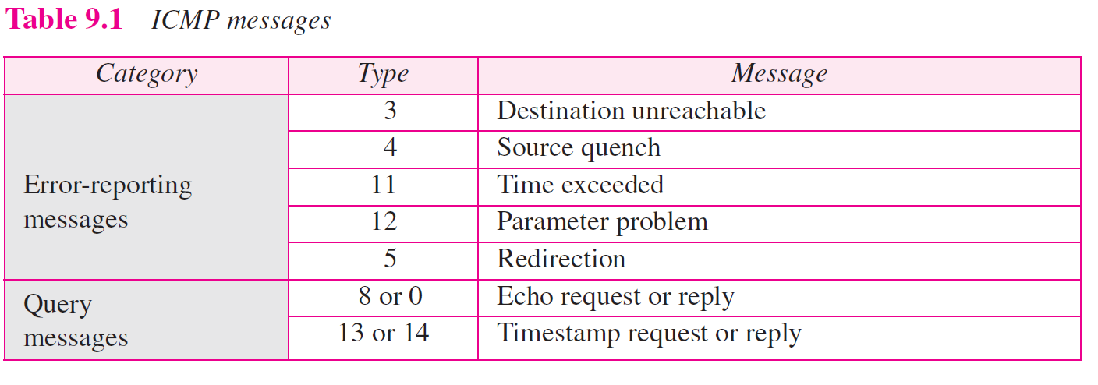

Slide 10
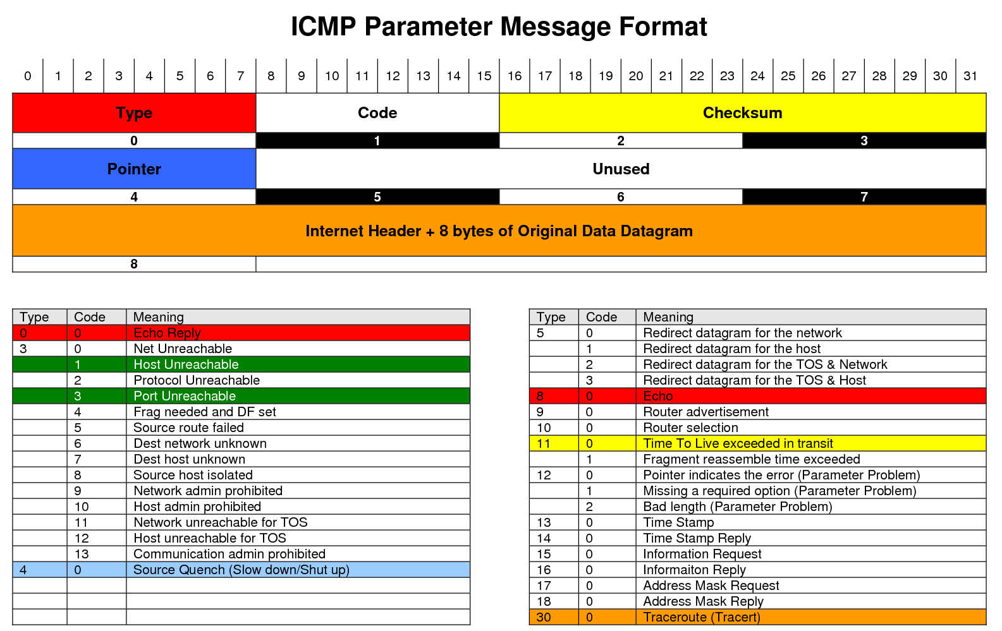

Slide 11
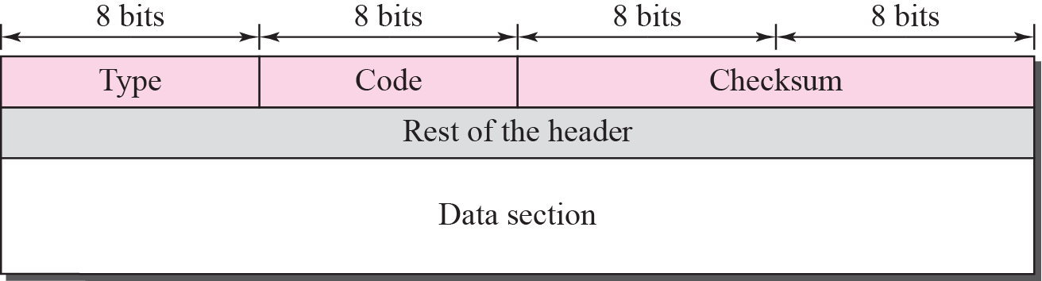
General format of ICMP messages

Slide 12

Note
ICMP always reports error messages to the original source.

Slide 13
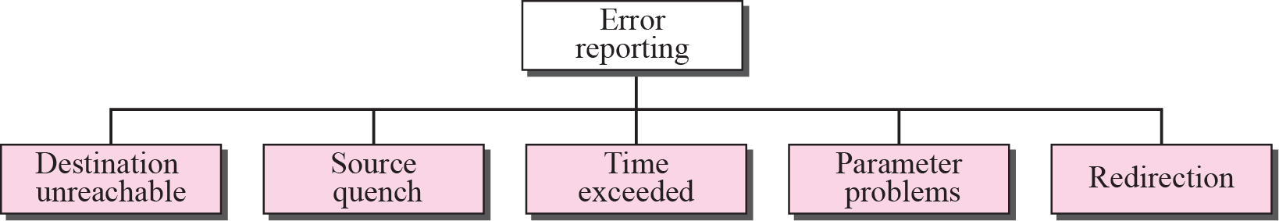
Error-reporting messages

Slide 14
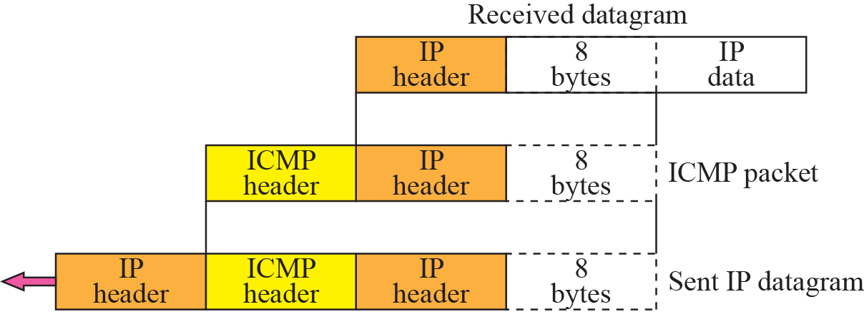
Contents of data field for the error message

Slide 15
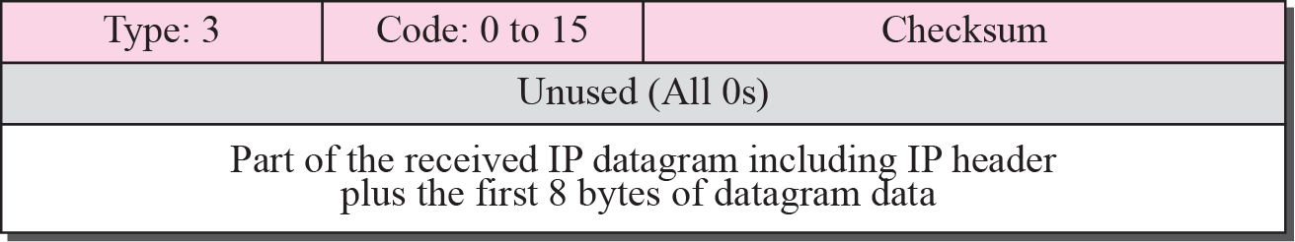
Destination-unreachable format

Slide 16
Note
Destination-unreachable messages with codes 2 or 3 can be created only by the
destination host.
Other destination-unreachable messages can be created only by routers.

Slide 17
Note
A router cannot detect all problems that prevent the delivery of a packet.

Slide 18
Note
There is no flow-control or congestion-control mechanism in the IP protocol.

Slide 19
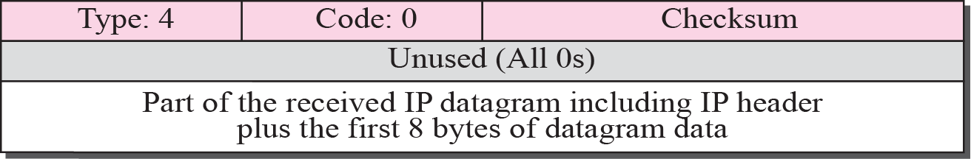
Source-quench format

Slide 20
Note
A source-quench message informs the source that a datagram has been discarded due to congestion in
a router or the destination host.
The source must slow down the sending of datagrams until the congestion is relieved.

Slide 21
Note
One source-quench message is sent for each datagram that is discarded due
to congestion.

Slide 22
Note
Whenever a router decrements a datagram with a time-to-live value to zero, it discards the datagram and
sends a time-exceeded message to the original source.

Slide 23
Note
When the final destination does not receive all of the fragments in a
set time, it discards the received fragments and sends a
time-exceeded message to
the original source.

Slide 24
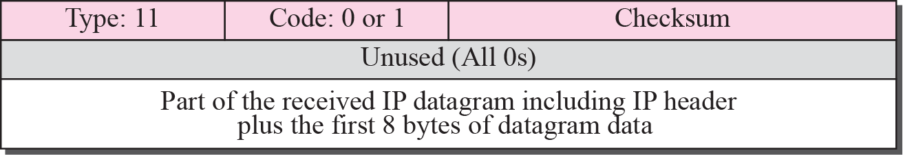
Time-exceeded message format

Slide 25
Note
In a time-exceeded message, code 0 is used only by routers to show that the value of the time-to-live field is zero.
Code 1 is used only by the destination host to show that not all of
the fragments have arrived
within a set time.

Slide 26
Note
A parameter-problem message can be created by a router or the destination host.

Slide 27
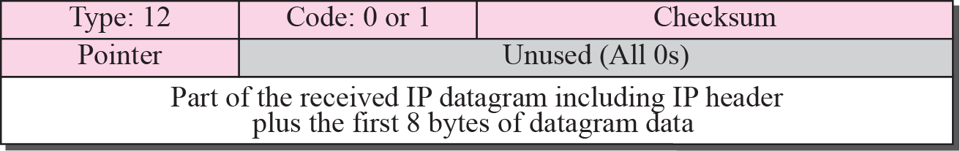
Parameter-problem message format

Slide 28
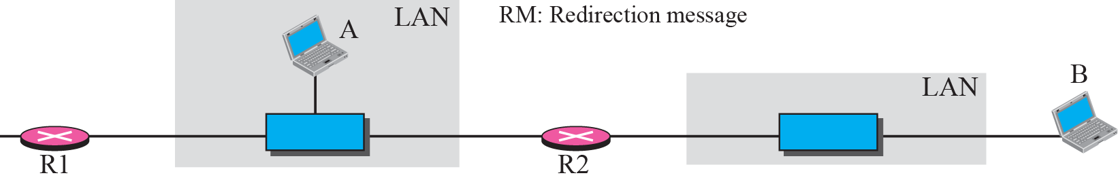
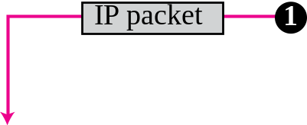

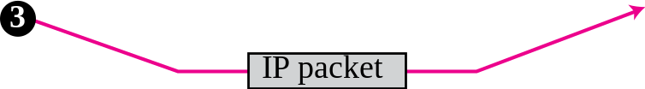
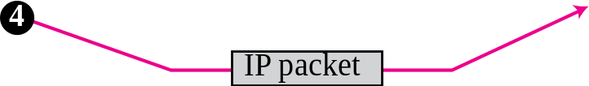
Redirection concept

Slide 29
Note
A host usually starts with a small routing table that is gradually augmented and updated.
One of the tools to accomplish this
is the redirection message.

Slide 30
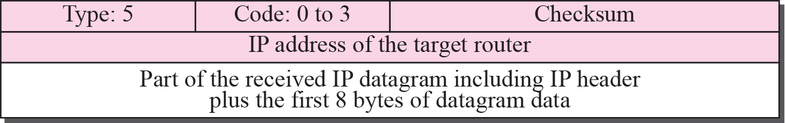
Redirection message format

Slide 31
Note
A redirection message is sent from a router to a host on the same local network.

Slide 32
Note
An echo-request message can be sent by a host or router.
An echo-reply message is sent
by the host or router that receives
an echo-request message.

Slide 33
Note
Echo-request and echo-reply messages can be used by network managers to check the operation of the IP protocol.

Slide 34
Note
Echo-request and echo-reply messages can test the reachability of a host.
This is usually
done by invoking the ping command.

Slide 35
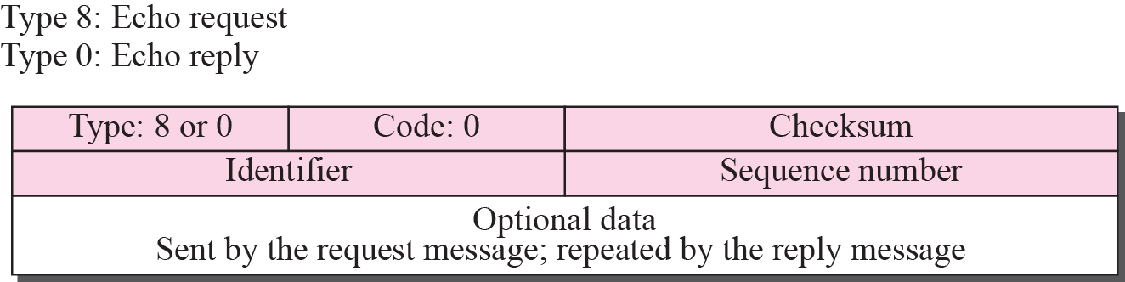
Echo-request and echo-reply message

Slide 36
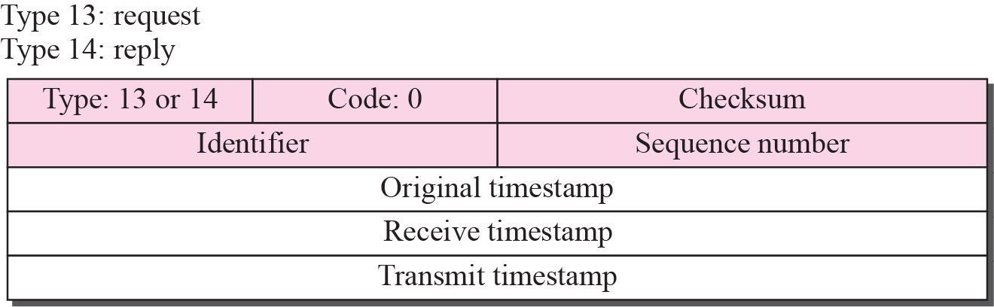
Timestamp-request and timestamp-reply message format

Slide 37
Note
Timestamp-request and timestamp-reply messages can be used to calculate the
round-trip time between a source and a destination machine even if their
clocks are not synchronized.

Slide 38
Note
The timestamp-request and timestamp-reply messages can be used to synchronize two clocks in two
machines if the exact one-way
time duration is known.

Slide 39
Example 9.1
Figure 9.14 shows an example of checksum calculation for a simple echo-request message (see Figure 9.12). We randomly chose the identifier to be 1 and the sequence number to be 9. The message is divided into 16-bit (2-byte) words. The words are added together and the sum is complemented. Now the sender can put this value in the checksum field.

Slide 40
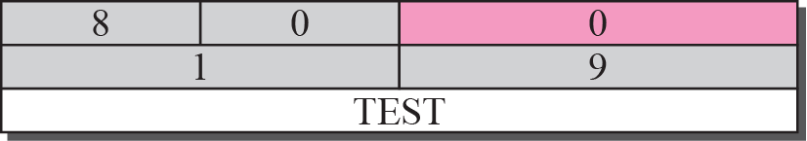

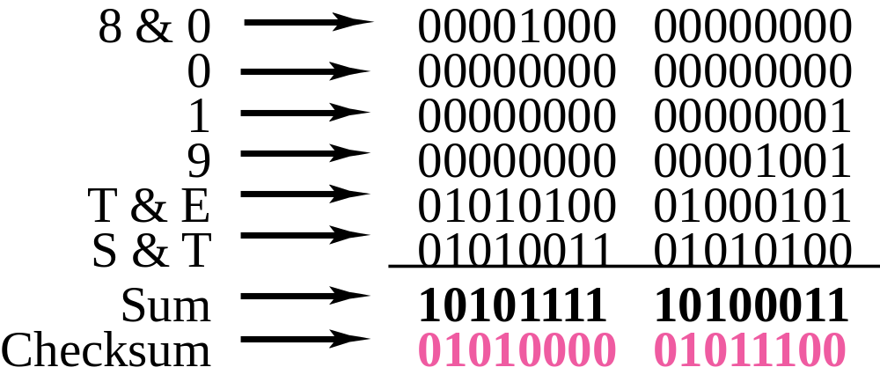
Example of checksum calculation

Slide 41
-3 DEBUGGING TOOLS
There are several tools that can be used in the Internet for debugging. We can find if a host or router is alive and running. We can trace the route of a packet. We introduce two tools that use ICMP for debugging: ping and traceroute. We will introduce more tools in future chapters after we have discussed the corresponding protocols.

Slide 42
Discussed in the Section
Ping
Traceroute

Slide 43
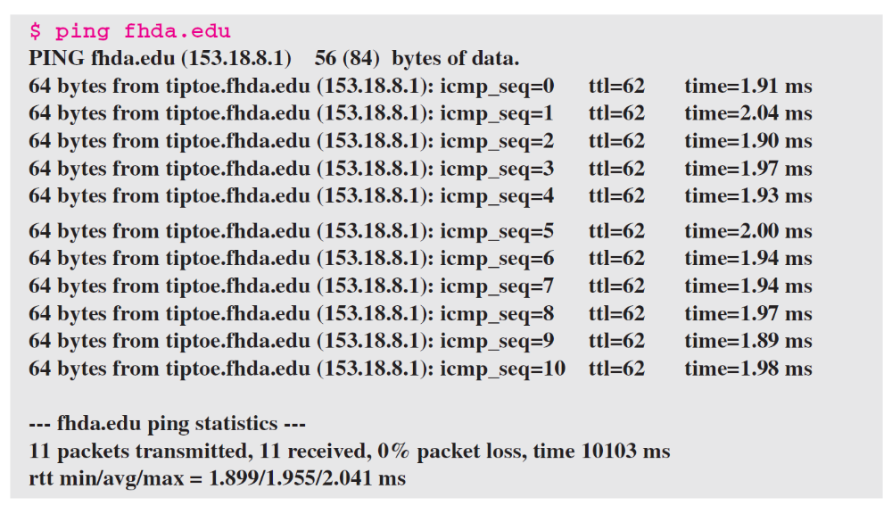
Example
We use the ping program to test the server fhda.edu. The result is shown below:

Slide 44
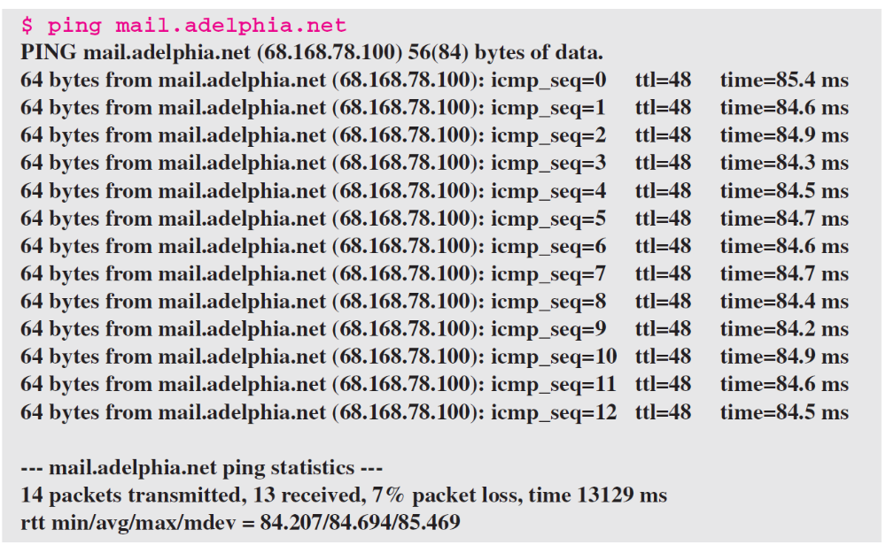
Example
For the second example, we want to know if the adelphia.net mail server is alive and running. The result is shown below: Note that in this case, we sent 14 packets, but only 13 have been returned. We may have interrupted the program before the last packet, with sequence number 13, was returned.

Slide 45
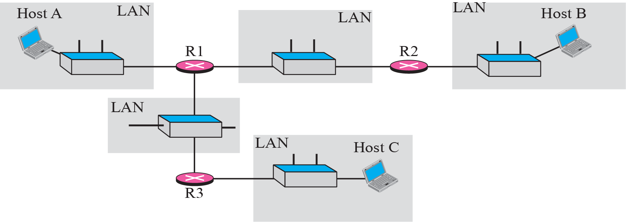
The traceroute program operation

Slide 46
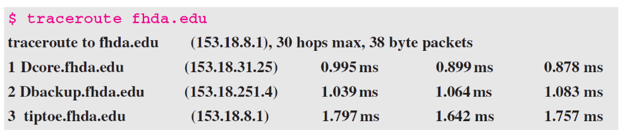
Example
We use the traceroute program to find the route from the computer voyager.deanza.edu to the server fhda.edu. The following shows the result.

Slide 47
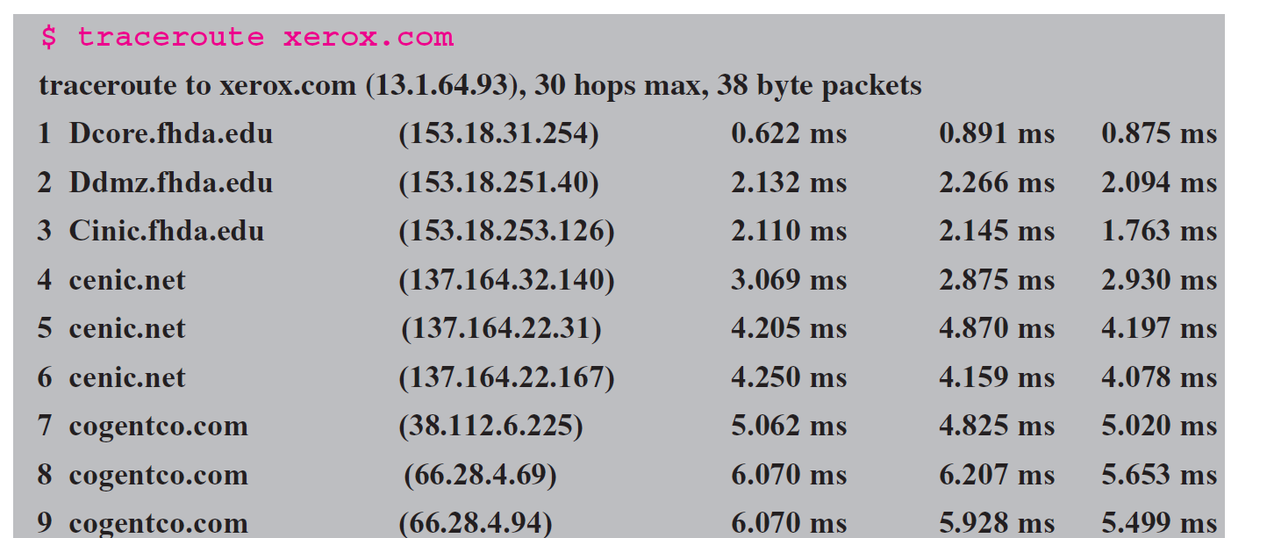
Example
In this example, we trace a longer route, the route to xerox.com. The following is a partial listing.

Slide 48
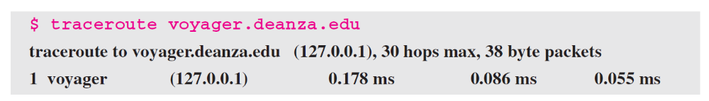
Example
An interesting point is that a host can send a traceroute packet to itself. This can be done by specifying the host as the destination. The packet goes to the loopback address as we expect.

Slide 49
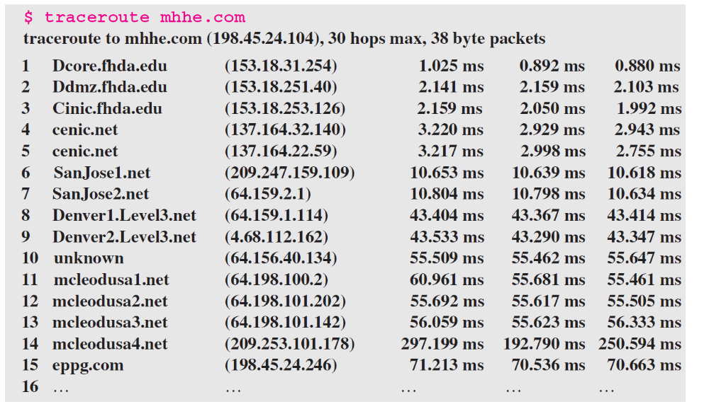
Example
Finally, we use the traceroute program to find the route between fhda.edu and mhhe.com (McGraw-Hill server). We notice that we cannot find the whole route. When traceroute does not receive a response within 5 seconds, it prints an asterisk to signify a problem (not the case in this example), and then tries the next hop.

Slide 50
-4 ICMP PACKAGE
To give an idea of how ICMP can handle the sending and receiving of ICMP messages, we present our version of an ICMP package made of two modules: an input module and an output module.

Slide 51
Discussed in the Section
Input Module
Output Module

Slide 52
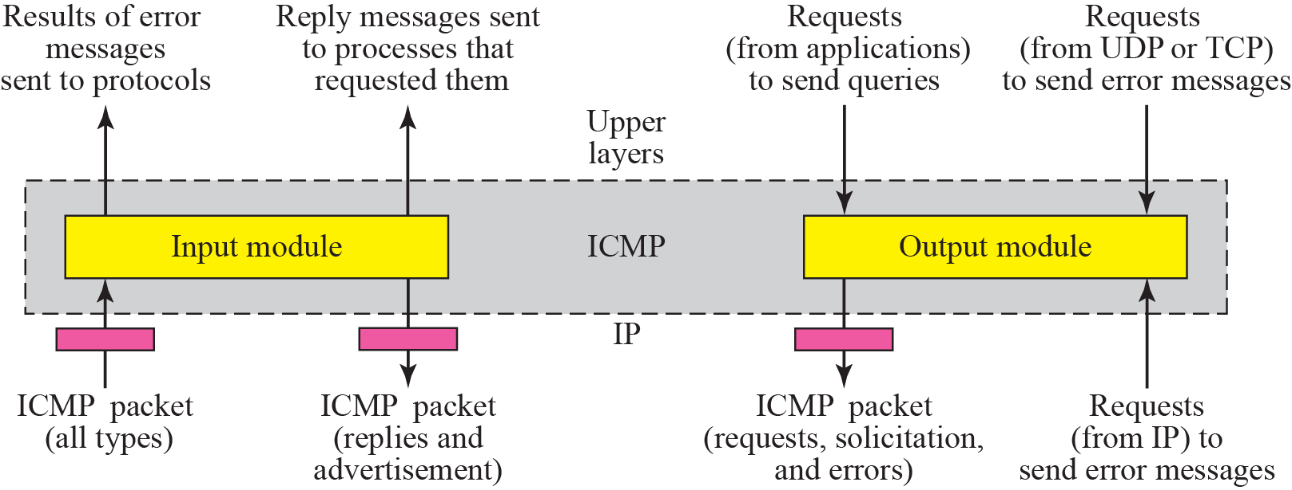
ICMP package

Slide 53
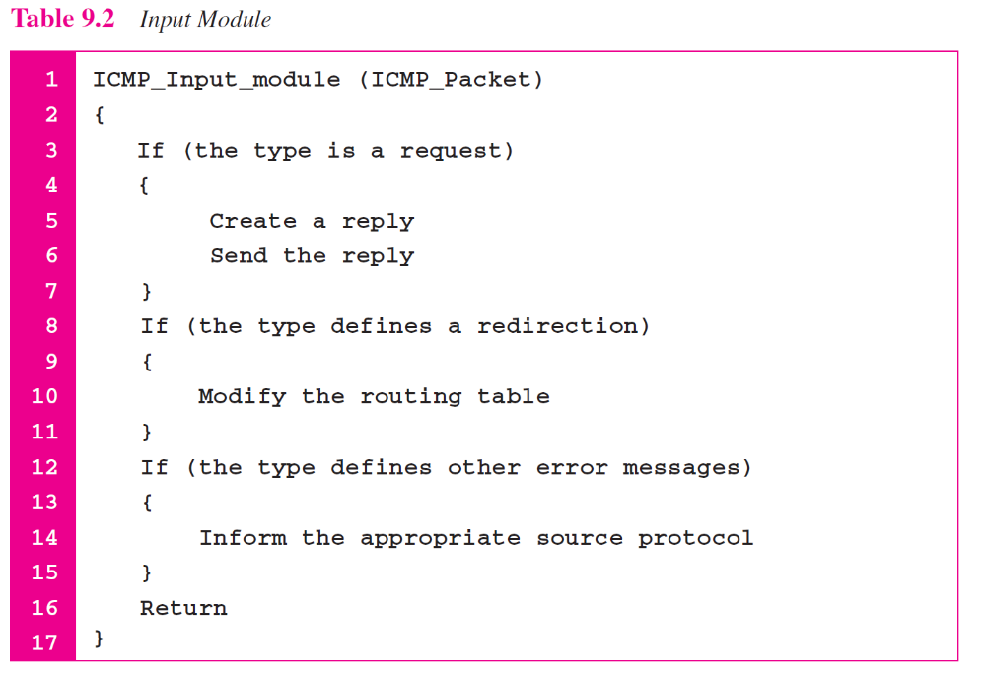

Slide 54
